Slide 1

Collaborative Online International Learning (COIL)
Projects at THUAS

Slide 3
Slide of contents
Slide 5: Key COIL Messages
Slides 7-9: COIL projects of European Studies
Slides 10-19: COIL projects of Nutrition and Dietetics
Slides 20-21: COIL project of Sports Management
Slides 22-23: COIL project of minor Journalism & Media
Slides 24-25: COIL project of Communicatie (Dutch)

Slide 4
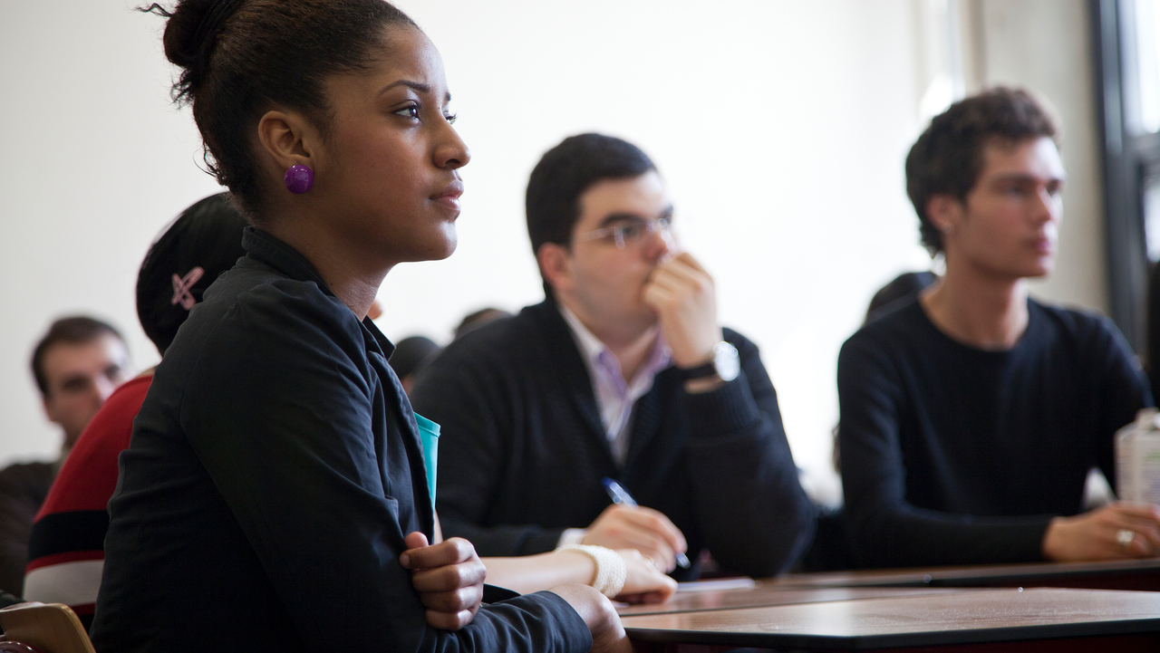
About COIL
1

Slide 5
Key COIL Messages
COIL is an inclusive and sustainable way for all our students to develop key 21st century skills and international competencies by connecting and collaborating with other students worldwide
COIL is student-driven and designed to solve problems together
COIL can be interdisciplinary
COIL is a great method to make students collaborate internationally online in a meaningful way in order to gain intercultural competences

Slide 6
Coil projects at Thuas
2

Slide 7
European Studies – Minor International Law (1)
THUAS Years 3 & 4
Partners HOSTOS Community College
          Various programmes
          Various years
Digital means Padlet
Contact Isabel Düsterhöft
i.k.dusterhoft@hhs.nl
Short description
Students worked on a multiple assignments together in groups to understand criminal justice from the US perspective (New York state law), the international approach (ICC) and the European viewpoint (depending on the nationalities in the class). They analysed two cases together, one at the NY state court and one at the ICC and reflected on various aspects of (international) criminal justice.

Slide 8
European Studies – Minor International Law (2)
COIL course duration
8 weeks
How long students work with each other?
There are no strict requirements as long as the work gets done by both groups together.
How many times students meet?
Students schedule their own time, some work synchronously, others not.
How do students meet?
Mostly met via Skype, FaceTime, zoom and WhatsApp, but the tools are up to them

Slide 9
Public International Law
Program European Studies – Minor International Law
THUAS Years 3 & 4
Partner Northeast Wisconsin Technical College
          Immigration Law course
          Years unknown
Digital means Facebook, Blackboard
Course Duration 12 weeks
Contact Mari-Jose Weijerman
m.j.weijerman@hhs.nl
Short description
The COIL course focus is on content learning & applying, not on acquiring 21st century skills or improving language skills (high on content, low on skills).
Learning objective of the coil part of the course: to develop & to increase awareness of the different takes/ viewpoints on the role of international law. Content allows for different interpretations, applications, analyses. 4 assignments for groups (4/5 persons per group).

Slide 10
Comparison of Dutch and Spanish National Nutritional Guidelines (1)
Program Nutrition & Dietetics
THUAS Year 2
Partner University of VIC
          Department of Nutrition and Dietetics
          Various years
  Artesis Plantijn University of Antwerp
          Department of Nutrition and Dietetics
          Years 2 & 3
Digital means Skype, Messenger & WhatsApp
Contact Inge Audenaerde
c.m.audenaerde@hhs.nl
Short description
The aim of the assignment was to exchange insights of food habits, culinary traditions and nutritional goals.

Slide 11
Comparison of Dutch and Spanish National Nutritional Guidelines (2)
COIL course duration
Unknown
How long students work with each other?
Unknown
How many times students meet?
It is up to them
How do students meet?
Skyping with each other almost once a week and e-mail to send files or documents to each other daily (comparison guidelines, menu, contacts) Facebook, not to miss any communications
Use WhatsApp to make appointments for meetings or to talk to the group. Then post the time and date for the meetings in the Facebook group.

Slide 12
Nutrition & Dietetics, Minor Sociology and Psychology of Food (1)
THUAS Years 2, 3 & 4
Partner State University New York Brockport
          Sport and Movement
          Year 3
Digital means Blackboard collaborative, Teams, Zoom, WhatsApp
Contact Simone Hackett
s.e.hackett@hhs.nl
Short description 1/2
This COIL assignment is part of a larger project. It is a section focusing on sport! Students are placed in teams of 6 (3 Dutch students and 3 US students) Their assignments involves teaching each other a specific (sports) motor skills so for example how to throw a rugby ball or an American football. The sports/movement they choose should be specifically American or Dutch. The Dutch teach the US students and the US students teach the Dutch. They make an instructional video on how to do the sport/movement which they send to each other. They then have weekly online sessions with each other in which they give explanations and feedback on progress as well as discuss other topics: stereotypes, culture, student life, politics USA versus NL and the rest of the world etc.

Slide 13
Nutrition & Dietetics, Minor Sociology and Psychology of Food (2)
COIL course duration
10 weeks
How long students work with each other?
Unknown
How many times students meet?
Unknown
How do students meet?
Classes are synced so that students can meet online during school hours each week. i.e. 9am USA time and 15hrs Dutch time. They get experience working online in a virtual team and not just online in the NL but online with students across the world.
Short description 2/2
The teams record each other practicing the sport (recording the first and last training session) at the end the teams give each other feedback on performance and progress. Together they make a presentation reflecting on their experience and applying (motor learning) theory on what they have observed in learning the motor skill. The entire course is online (usually blended format but because of covid everything online).

Slide 14
Nutritional habits, food patterns and national recommendations (1)
THUAS Year 1
Partner Birmingham City University
          Course unknown
          Most in year 1
Durban University of Technology
          Course unknown
          Most in year 1
University of Applied Sciences for Health Professions Upper Austria
          Course unknown
          Most in year 1
Coventry University
          Course unknown
          Most in year 1
Short description
Students compare cultural food habits, conduct a dietary analysis of their buddy, compare nutritional guidelines and the healthy eating model of both countries and give advice to the other student.

Slide 15
Nutritional habits, food patterns and national recommendations (2)
Digital means Blackboard, Padlet, Moodle
Contact Tonnie Genugten
a.h.m.vangenugten@hhs.nl
Course duration 6 weeks
How long students work with each other?
20 hours
How many times students meet?
3 times
How do students meet?
Unspecified

Slide 16
Health promotion across borders (1)
Program Nutrition and Dietetics
THUAS Year 1
Partner SUNY Oswego
          Course unknown
          Most in year 1
Digital means Blackboard, Padlet, Moodle
Contact Tonnie Genugten
a.h.m.vangenugten@hhs.nl
Short description
Students work on a public health assignment on both sides. In the COIL assignment they will share community analysis and target groups for a specific intervention to make the target group more healthy. The COIL assignment is based on sharing their experiences and comparing differences.

Slide 17
Health promotion across borders (2)
COIL course duration
6 weeks
How long students work with each other?
20 hours
How many times students meet?
3 times
How do students meet?
Unspecified

Slide 18
Food Quality and Hygiene (1)
Program Nutrition and Dietetics
THUAS Year 1
Partner Coventry University
          Course unknown
          Most in year 1
Digital means Blackboard, Padlet, Moodle
Contact Tonnie Genugten
a.h.m.vangenugten@hhs.nl
Short description
Students develop a meal, compare ingredients and food safety matters. This results in a video showing your cooking process.

Slide 19
Food Quality and Hygiene (2)
COIL course duration
6 weeks
How long students work with each other?
20 hours
How many times students meet?
3 times
How do students meet?
Unspecified

Slide 20
Sport Management International Online (1)
Short description
Online lectures with online group assignments
Final week at one of the universities with lots of visits.
THUAS Years 3 & 4
Partner JAMK University, Finland
          Sport Business School
          Year 3
SUNY Cortland, NY
          Sport Management
          Year 3
Bigli University, Turkey
          Sport Management
          Years 2, 3 & 4
Digital means Skype, WhatsApp, Finnish Blackboard (Optima)
Contact Noud van Herpen
n.a.vanherpen@hhs.nl

Slide 21
Sport Management International Online (2)
COIL course duration
11 weeks
How long students work with each other?
Unknown
How many times students meet?
Some students travel to The Hague for 1 week of seminars. This appears to be a special case.
How do students meet?
In person and on Skype and WhatsApp.

Slide 22
Assignment for practical portfolio for Journalism and Media (1)
THUAS Years 2 & 3
Partner Queens College, NY
          Statistics applied to business
          and economics
          Year 2
Digital means WhatsApp and Skype
Contact Dominique Darmon
d.darmon@hhs.nl
Short description
The students had to write a journalistic article on a global issue while the Queens’ students had to conduct research on that same issue, using statistics and interviews. They first had to do ice breakers such as videos to introduce themselves. Then it was up to them how often they wanted to meet to work on their case.

Slide 23
Assignment for practical portfolio for Journalism and Media (2)
COIL course duration
6 weeks
How long students work with each other?
It was up to them how often they wanted to meet to work on their case. Some spent more time than others.
How many times students meet?
Some met more than others
How do students meet?
WhatsApp and Skype

Slide 24
Duurzame wereld - Intercultural Communication (1)
Short description
Students learn:
how to make acquaintances with people from another culture (synchronous/asynchronous)
how to start a dialogue
how to communicate appropriately through e-mail, skype (and maybe other media)
how to interview someone from another culture (about a topic of choice).
how to seek and obtain help from someone from a different culture
how to help others by providing own insights to someone from a different culture
how to cooperate online on solving problems collaboratively.
THUAS Year 2
Partner Yuan Ze University, Taiwan
          Strategic Communication, Language and Culture
          Year 1
Coventry University, UK
          Lifestyle Trends, Health and Behaviour Change
          Promoting Healthy Communities
          Year 2 & 3
Digital means E-mail, skype, MS teams, WhatsApp, FaceTime
Contact Claudia Diers Linke
c.t.diers-lienke@hhs.nl

Slide 25
Duurzame wereld - Intercultural Communication (2)
Course duration
5 weeks
How long students work with each other?
Unspecified
How many times students meet?
Students meet at least 2 times per week online
How do students meet?
This is both asynchronous (in their own time, student-driven, in small teams, using a channel or medium (like e-mail, skype, MS teams, WhatsApp, FaceTime or other apps of their own choice) and synchronous (during class, teacher-driven, through MS Teams).

